Slide 1
On-The-Fly Control of Unknown Smooth Systems from Limited Data
Franck Djeumou, Abraham P. Vinod, Ufuk Topcu
The University of Texas at Austin, USA
Eric Goubault, Sylvie Putot
École polytechnique, France
Notes:
Hi everyone, I’m Franck djeumou from the autonomous systems group at the University of Texas at Austin and in this presentation, I’ll describe a learning-based approach for on-the-fly control of systems with unknown dynamics using serverly limited amount of data

Slide 2
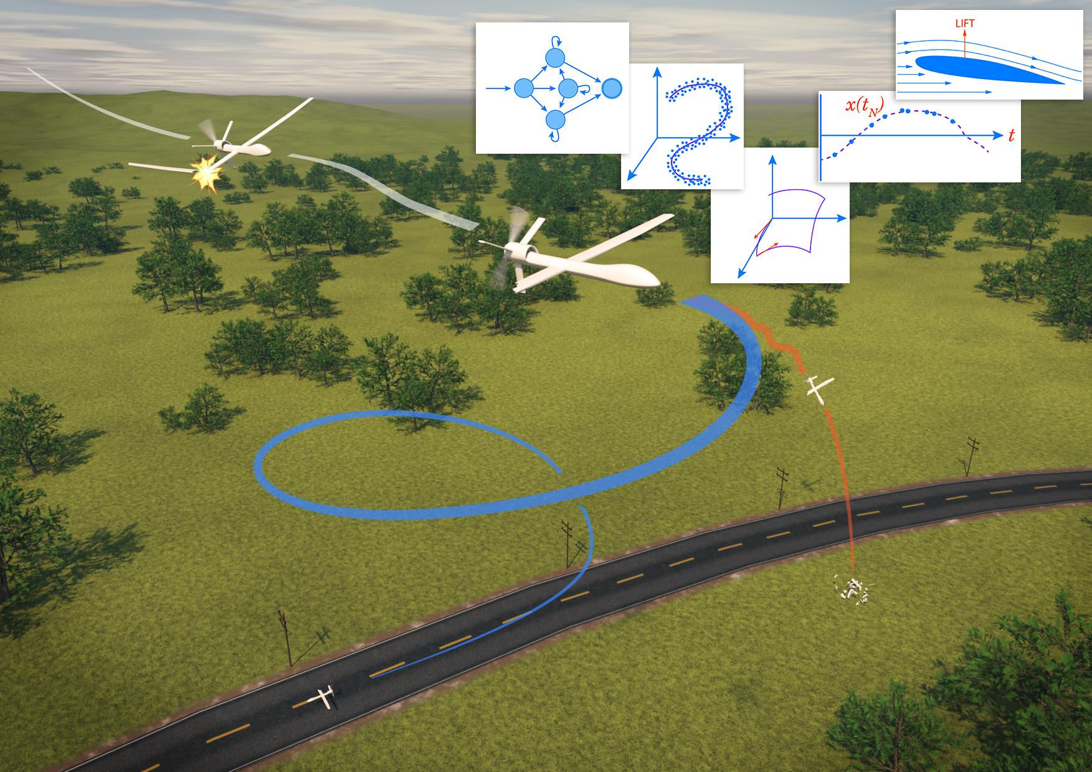
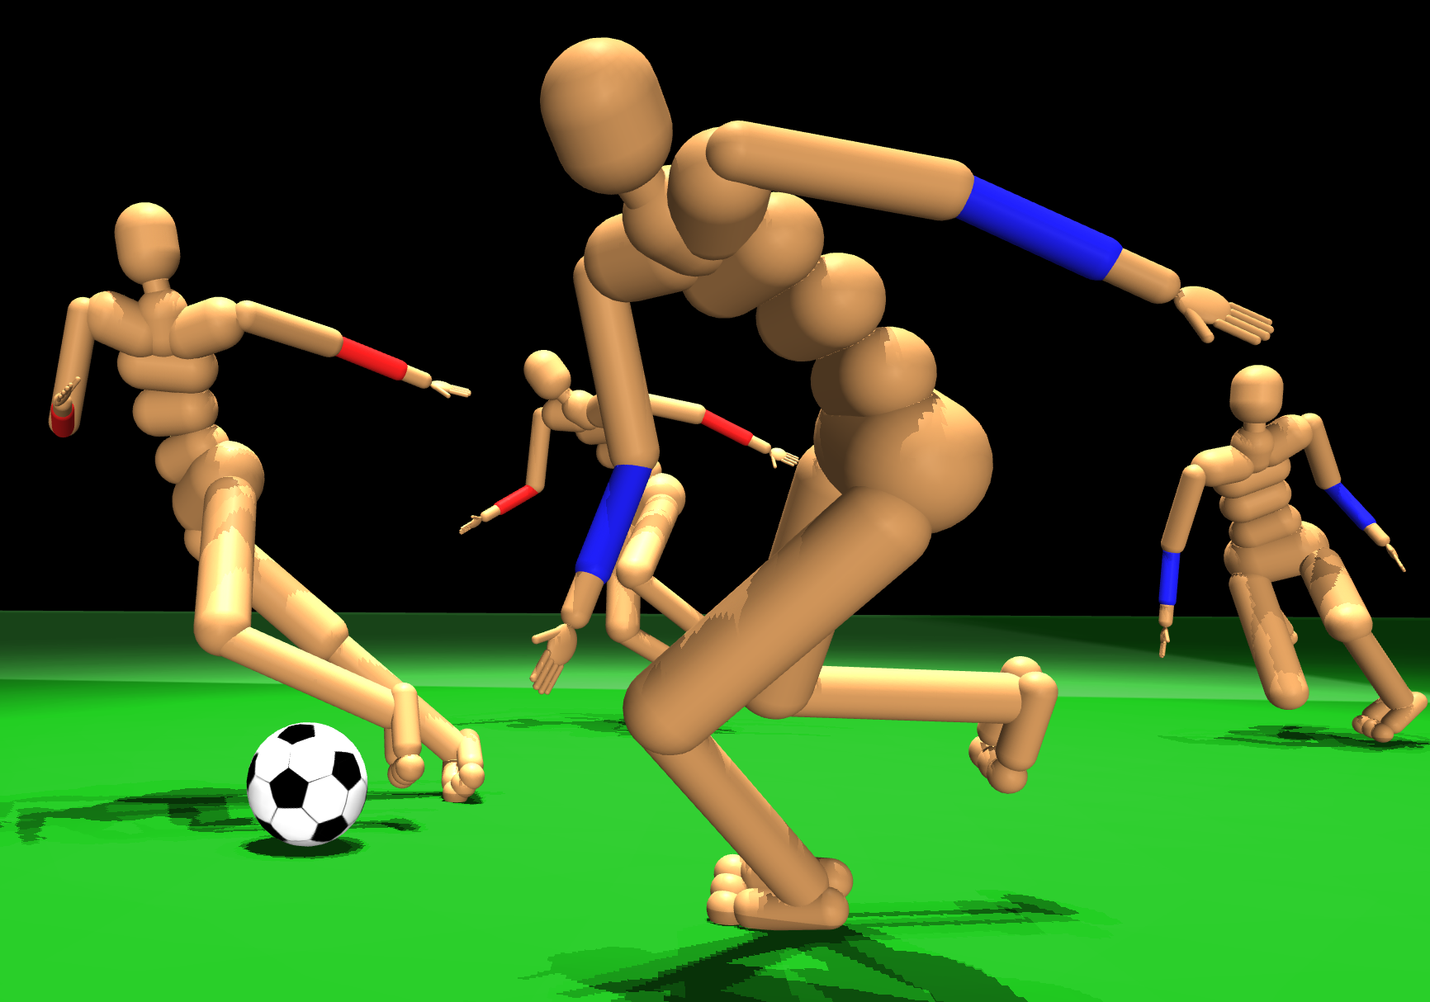
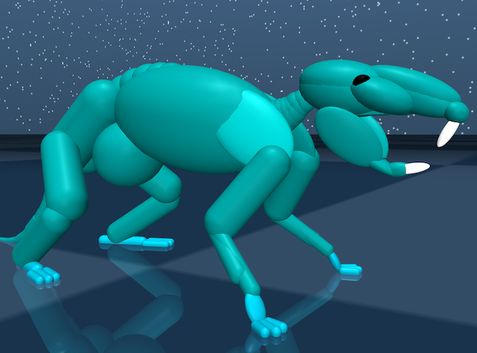
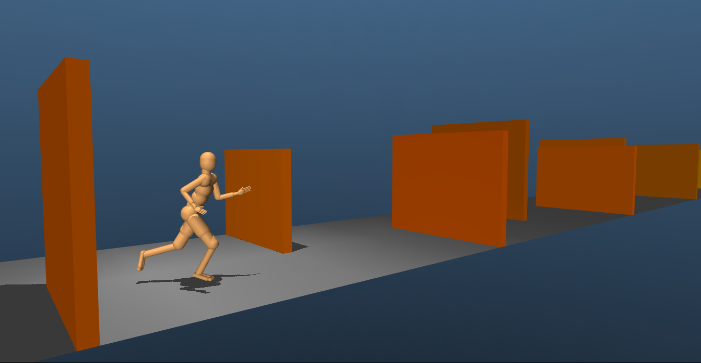
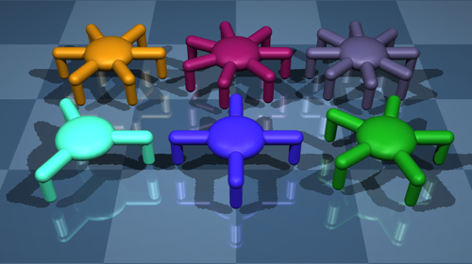
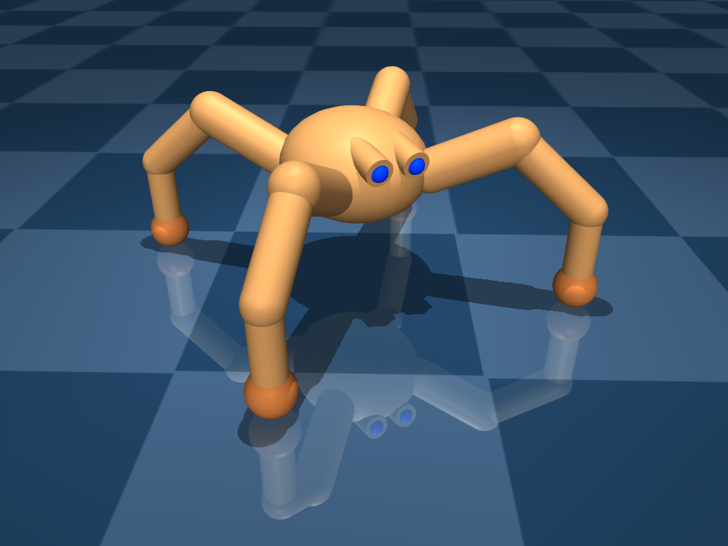
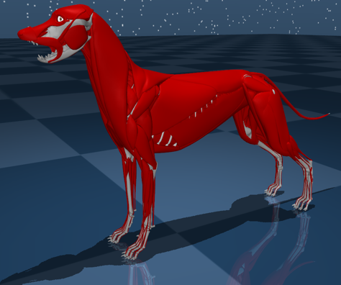
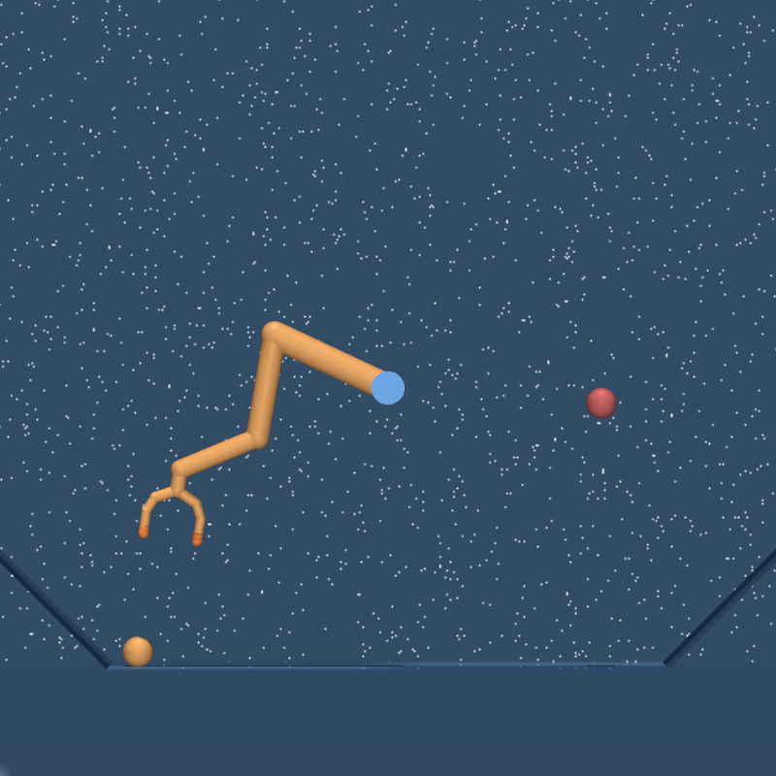
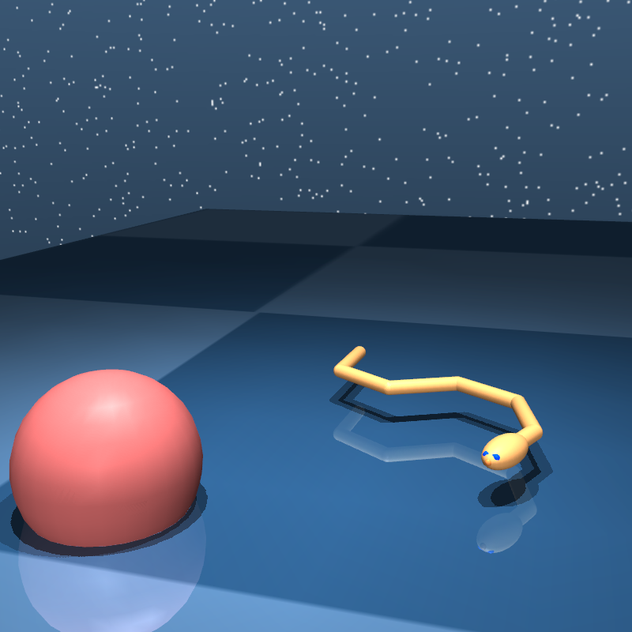
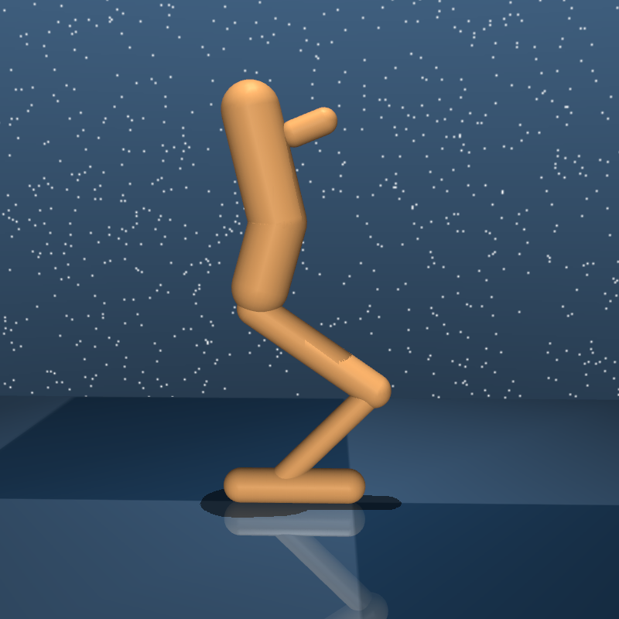
Learning On The Fly from Severely Limited Data
Aircraft undergoes unexpected damages during flight
Learning for robotics
Source: The Aviationist
Source: DeepMind
Is it even possible to learn how to control in one attempt?
Notes:
A rather extreme motivating scenario for learning on the fly from severly limited data is an aircraft undergoing unexpected changes in its dynamics during a flight.
For example, the changes can be due to the loss of an engine or a wing
In this scenario, there is a need to learn the new dynamics after the damage in order to retain a certain degree of control
Furthermore, any learning algorithm to be used in the scenario will only have access to streaming data from the ongoing trajectory of the system
Another field where learning from limited data is crucial is the robotic field where excessive number of attempts cannot be performed on the physical vehicle
Sooo in this paper, we are trying to answer if it is even possible to learn how to control in one attempt?

Slide 3
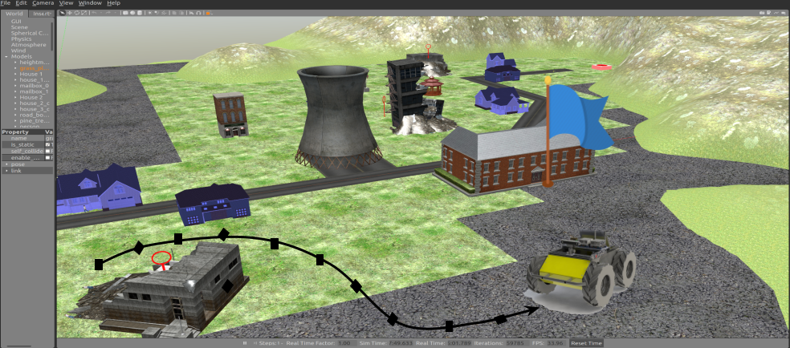
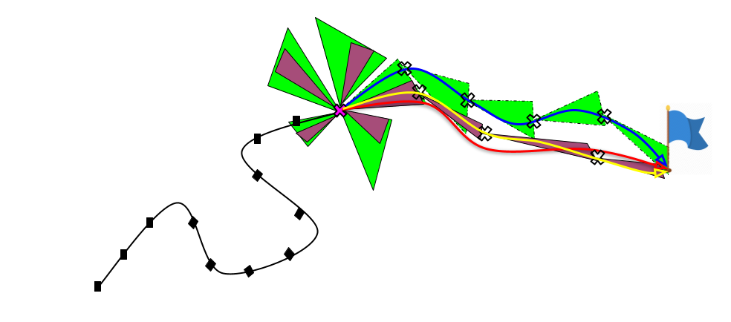
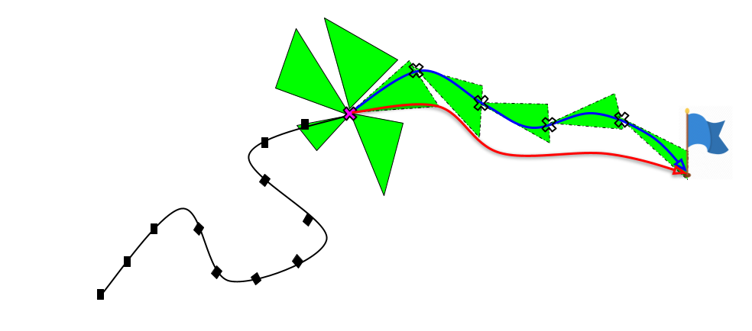
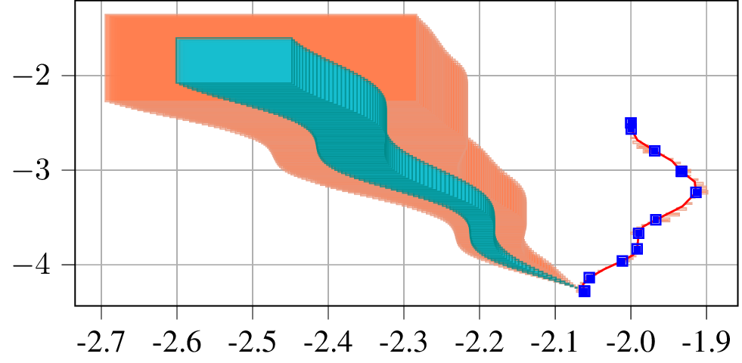
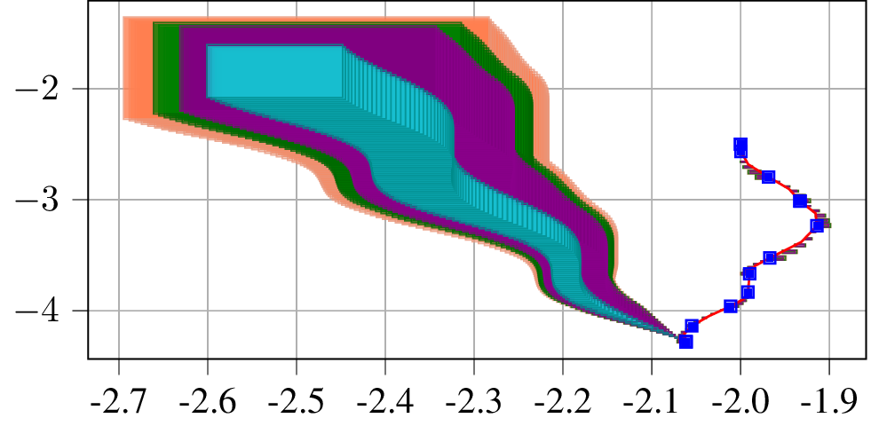
Learning to Control in One Attempt? No Problem
Given:
Streaming data from ongoing trajectory
Side information, if available
Data-driven over-approximations of reachable sets
On-the-fly control with provable guarantees
Crucial for safety concerns
Near optimality: Bound on suboptimality error
Tighter sets with more data or side information
Real-time: Bound on number of flops^{[1]}
No side information
Over-approximations for various controls
Control with no side information
Side information 1
Control with side information
Goal
Side information 1 and 2
Reachable set
Optimal control
suboptimality error
Data points
Ongoing trajectory
[1] F. Djeumou et al, ‘On-The-Fly Control of Unknown Systems: From Side Information to Performance Guarantees through Reachability’, IEEE-TAC, 2020
Notes:
Our answer is YES
We develop algorithms able to learn to control in one attempt using only streaming data from ongoing trajectory
AND if available, various forms of side information on the underlying unknown dynamics
The side information are typically derive from elementary laws of physics or qualitative properties of the system
Specifically, we develop a data-driven algorithm for the over-approximation of the set of states the system may reach
And as you all know, the reachable set are crucial for safety analysis
We show that more data and sisde information provide tighter over-approximating set
THEN, we leverage the over-approximation of the reachable to provide an algorithm for on-the-fly control with provable guarantees.
We prove that the algorithm is near-optimal with a bound on the suboptimality with respect to the case where the dynamics are known AND we show that more data and availabe side information enable to reduce the suboptimality of the control
Finally, in a recent submission, we prove the real-time capability of the algorithm with a bound on the number of elemetary operations required to find near-optimal control values

Slide 4
Numerical Experiments
Comparison with system identification and contextual optimization approaches
Significantly improved suboptimality
Three orders of magnitude faster
Recent work: Data-driven control in a high-fidelity F-16 aircraft simulator
Notes:
Additionally, we empirically demonstrate on a unicycle and a quadrotor system that our approach outperforms in terms of optimality and computation time, state-of-the-art system identification and contextual optimization based approaches.
In a recent submission, we successfully applied our learning-based approach in a high-fidelity F16 aircraft simulator. The F-16 starts at a low altitude with a high picth angle towards the ground and the goal is to avoid the collision using data obtained while falling. We compared our approach with the pre-tuned LQR controller of the simulator.

Slide 5
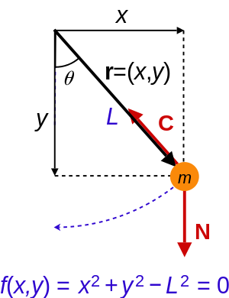
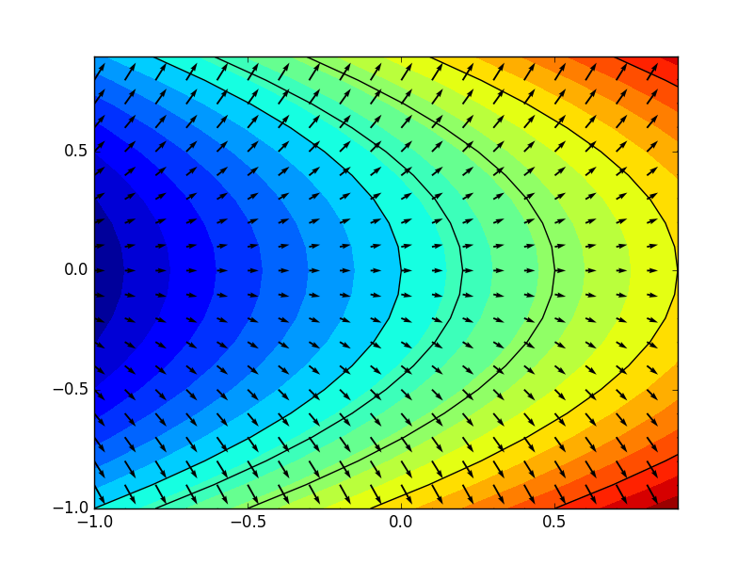
Formal Problem Description
Consider a system with unknown nonlinear dynamics in control-affine form
Constrained signal of time in
Unknown Lipschitz functions on
Given:
Data from ongoing trajectory
Side information
Lipschitz bounds
Algebraic constraints
Local gradient bounds
Known terms of dynamics
Problem 1: Compute an over-approximation of the reachable set of the system
Problem 2: At each time , Compute a solution to the one-step optimal control problem
Cost function
Unknown future state
Data points
We can only hope for approximate solutions
Notes:
The approach in this work considers unknown nonlinear dynamics in control-affine form where the control is a constrained signal of time and the functions defining the vector field are unknown Lipschitz functions.
Given streaming measurements of the state, the state derivative and control signal applied
AND,,,, if available side information such as Upper bound on the LIpschitz constants of f and G
Local gradient bounds, for example monotonicity of the vector field
Algebraic constraints on the states,
or possible knowledge of part of the dynamics
The first problem of interest is to compute an over-approximation of the set of states the system may reach
The second problem is to compute at each discrete time a solution to the one-step optimal control problem that you can see on the slide
Here, c is a one-step cost function that encodes the desired behavior of the system
The future state value cannot be predicted since the dynamics are also unknown
THerefore, we are trying to optimize an unknwon function and we can only hope to provide approximate solutions.

Slide 6
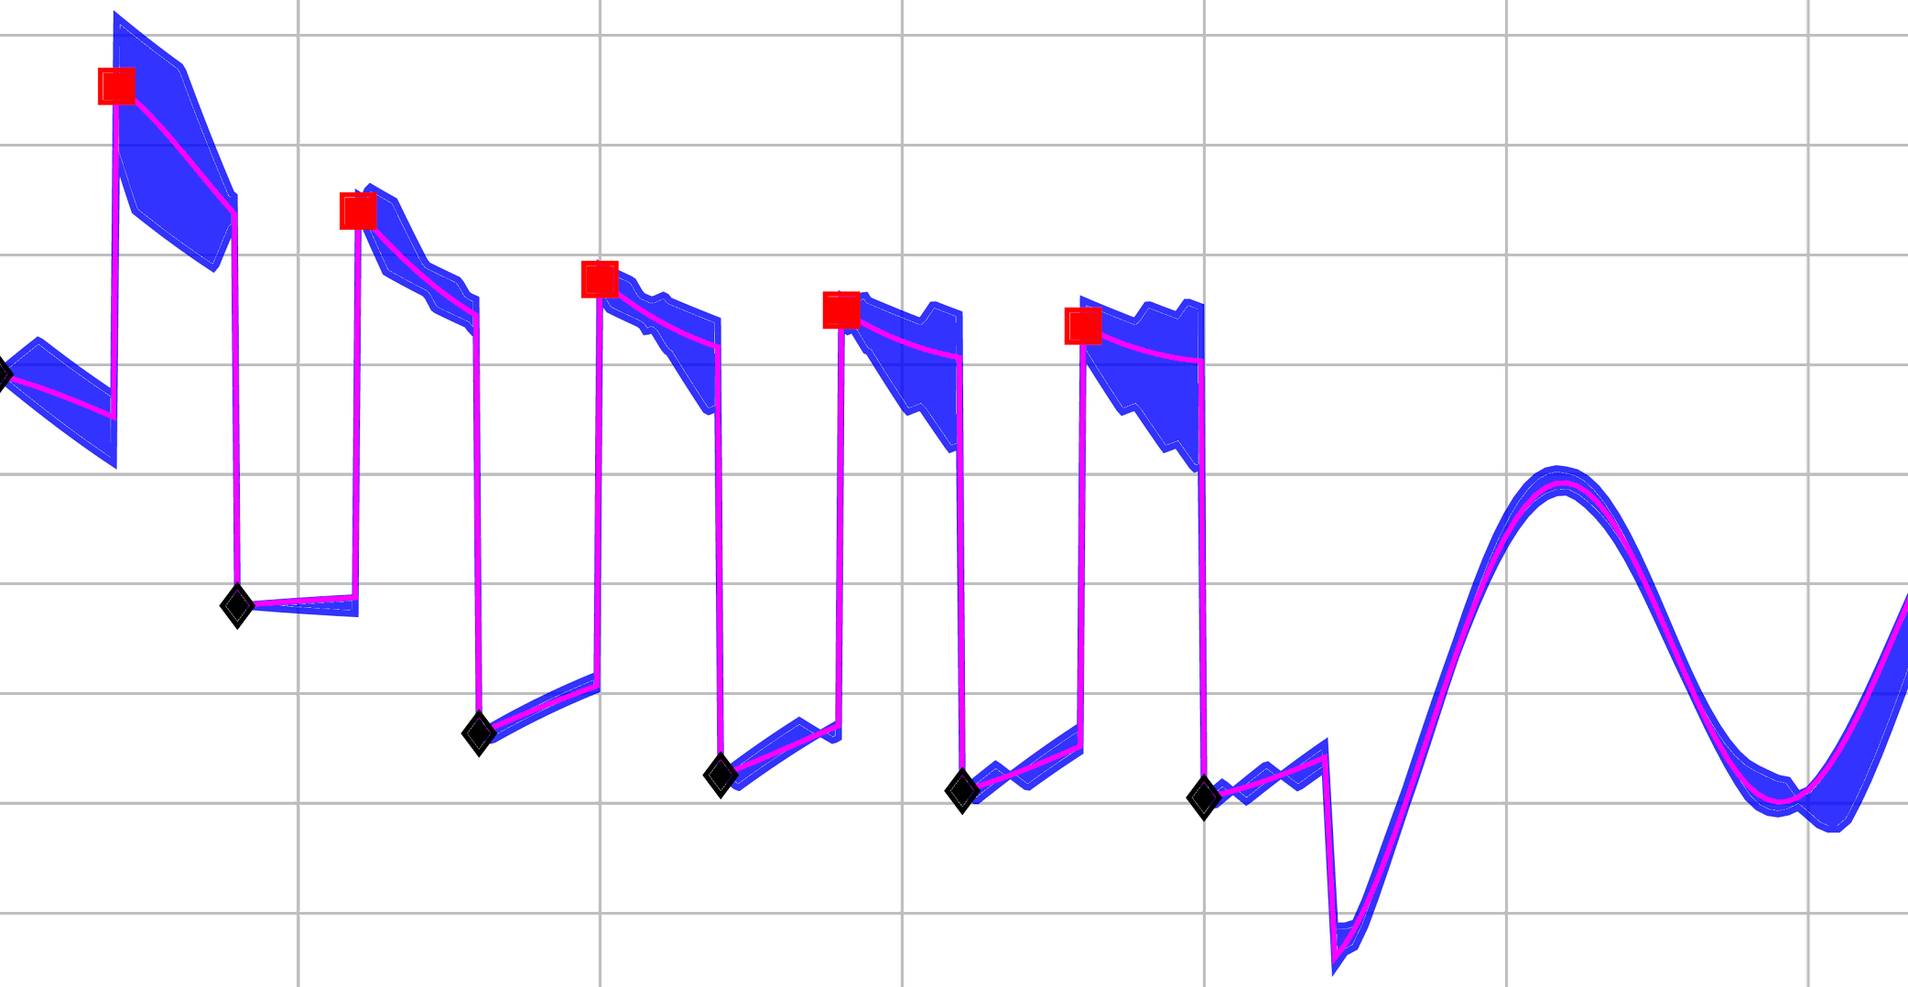
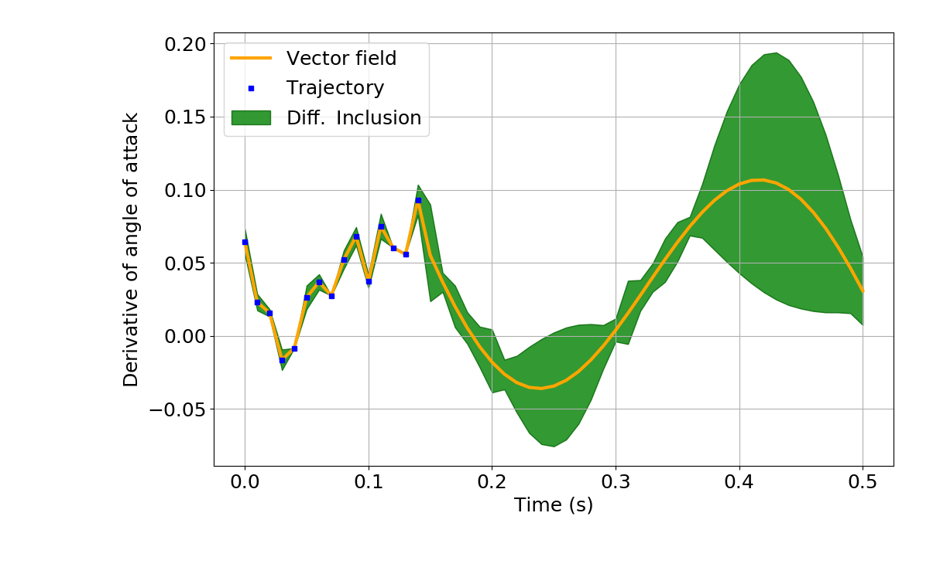
Solution Approach in a Nutshell
Convex relaxations
Control-affine linearization of reachable set
Convexification
Near-optimal control
5
4
Unknown dynamical system
Linearization around control
Upper bound on Lipschitz constants
Side information
Over-approximations of Reachable Sets
Data-driven differential inclusion
over-approximate set
1
Reachable set
Interval Taylor-based methods
Data points
3
2
Notes:
Our solution approach can be summarized as follows
For every new measurements, we use upper bound on the Lipschitz constants of f and G, and any available side information to construct and refine a differential inclusion that is guaranteed to contain the unknown vector field
Then, we build on Interval Taylor-based methods to provide a closed-form expression to over-approximate the reachable sets of all feasible dynamics of the obtained differential inclusion
The closed-form expression is a nonconvex function of the control, thus we provide a control-affine linearization of the over-approximation which is finally used to construct convex relaxations of the one-step optimal control problem allowing near-optimal control of the system.

Slide 7
Data-Driven Differential Inclusion for Unknown Dynamics
New data point
Unknown f or G
Initial data point
Refined initial vector field over-approximation
Initial vector field over-approximation
Vector field over-approximation with Lipschitz bounds
Refined vector field over-approximation with the dynamics constraint
Notes:
So the first step in our solution approach was to construct a differential inclusion containing the unknown vector field.
To achieve this we are going to over-approximate the unknown function f and G at each given data point.
So given an initial data point, we start by considering a large over-approximation of the function f and G at the corresponfing state
Then, for a new data point, we use the upper bound on the LIpschitz constants to deduce the set of values of f and G at the new point
The obtained set can be further tighten by pruning out from f and G, value that are not dynamically feasible. Specifically, we remove values of the intial over-approximation of f and G that do not sum up to the measured velocities x dot
The new set can be used to refined our estimate of at intiial data point
And propagating this refinement procedure for new data points enable to construct and refine the desired differential inclusion

Slide 8
Data-Driven Differential Inclusion for Unknown Dynamics
New data point
Unknown f or G
Initial data point
Refined initial vector field over-approximation
Initial vector field over-approximation
Vector field over-approximation with upper Lipschitz bounds
Refined vector field over-approximation with the dynamics constraint
Data-driven differential inclusion:
Notes:
And propagating this refinement procedure for new data points enable to construct and refine the desired differential inclusion

Slide 9
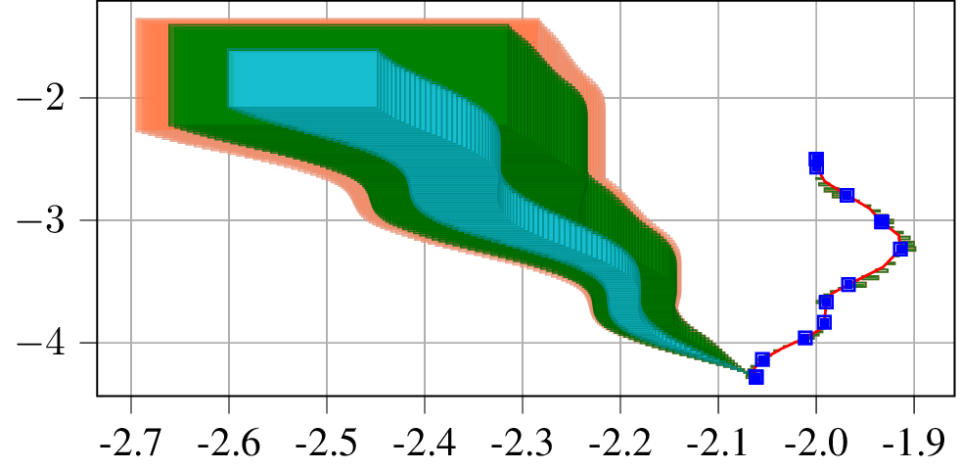
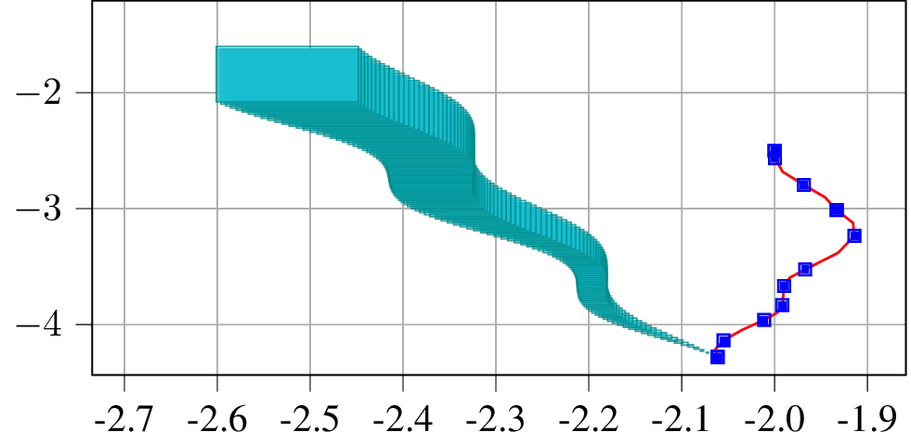
Data-Driven Over-Approximations of Reachable Sets
Closed-form expression for over-approximations of reachable sets
Over-approximation
Current set of states
Set of control values
Control derivatives
A Rough enclosure
Known dynamics case
Unknown dynamics case
Over-approximations of Jacobian values
Loose Lipschitz bounds
Loose Lipschitz bounds + decoupling
Side information provides tighter sets
Exact Lipschitz bounds + decoupling
Example: A unicycle system
reachable set
Loose Lipschitz bounds
Data points
Decoupling: Vector field independent of positions
Notes:
We used the constructed differential inclusion to provide a closed-form expression for over-approximations of reachable sets
In the case the dynamics are known, it is well known that an over-approximation R at time t_{j+1} can be computed through the set of states at time j, the set of admissible control values and derivative control values and finally an a priori rough enclosure of the over-approximation of the reachable set
This expression uses the knowledge that f, G, and their respective Jacobians are known and can be evaluated approximately for any input set values.
In the case of unknown dynamics, we show in the paper that a similar closed-form expression can be obtained by using the differential inclusion and replace the unknown jacobian with over-approximations derived from lipschitz bounds
Furthermore, we show that side information enforces additional constraints on the differential inclusion and the over-approximation of the jacobians, hence it enables to obtain tighter over-approximating sets.
As an illustration, consider a unicyle system whose position on the x and y axis are given by px and py, and its orientation given by theta
Given a single trajectory and side information on the unknown dynamics such as loose LIpschitz bounds and the knowledge that the vector field is identpendent of its position, we show that with both loose lipschitz bounds and decoupling, we achieve tighter sets than with only the loose lipschitz bounds. Moreover, knowing the exact lipschitz bounds enable to significantly tighten the over-approximating set

Slide 10
Solving (Approximately) the One-Step Optimal Control Problem
Unknown future state
Cost function
Optimistic control
Pessimistic control
Non-convex in control values
Control-affine linearization
Convex-optimization-based, on-the-fly control
Notes:
For the problem of solving the one-step optimal control problem
The main idea is to replace the unknwon future state with the corresponding over-approximation of the reachable set.
Doing so enables to obatin two optimization problems. And optimistic control problem where we seek for control values that minimize the best possible cost over the over-approxmation set while the pessimistic control problem considers the worst possible case
THese two problems are not convex since the closed form expression is nonconvex in the control
We leverage a control affine linearization of the over-approximation of the reachable set to provide convex-optimization-based, on-the-fly control of unknown systems

Slide 11
Provable Performance Guarantees: Near-Optimal and Real-Time
The suboptimality error is proportional to the width of the over-approximation of the reachable set
Control with no side information
Control with side information
Width of an interval
Lipschitz bound of the cost
Goal
More data and available side information reduce the suboptimality error
Optimal control
suboptimality error
Ongoing trajectory
Upper bound on the number of flops required to compute near-optimal control values^{[1]}
Linear in the number of samples
Quadratic in number of inputs and states
[1] F. Djeumou et al, ‘On-The-Fly Control of Unknown Systems: From Side Information to Performance Guarantees through Reachability’, IEEE-TAC, 2020
Notes:
Additionally, we prove that the gap between the optimal cost when the dynamics are known and the cost computed by our approach is bounded by the width of the over-approximation of the reachable set
The immediate consequence is that the suboptimality error will be reduced with more data and side information since we show that they enables to obtain tighter over-approximations
Finally in our recent work, we were able to provide a bound on the number of elemetary operations required to compute near-optimal control values. THe bound is linear in the number of data of the ongoing trajectory and quadratic in the number of inputs and states

Slide 12
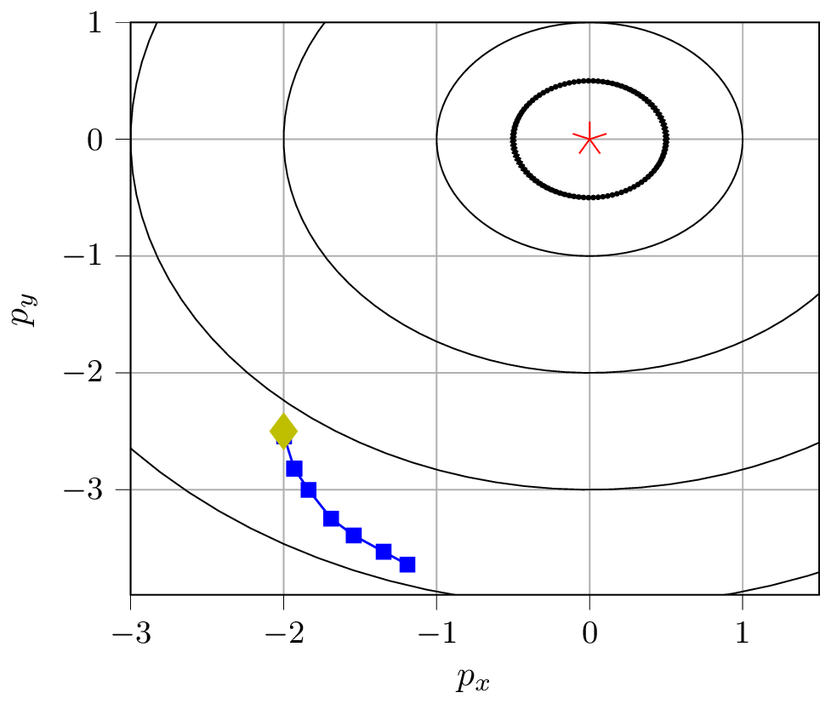
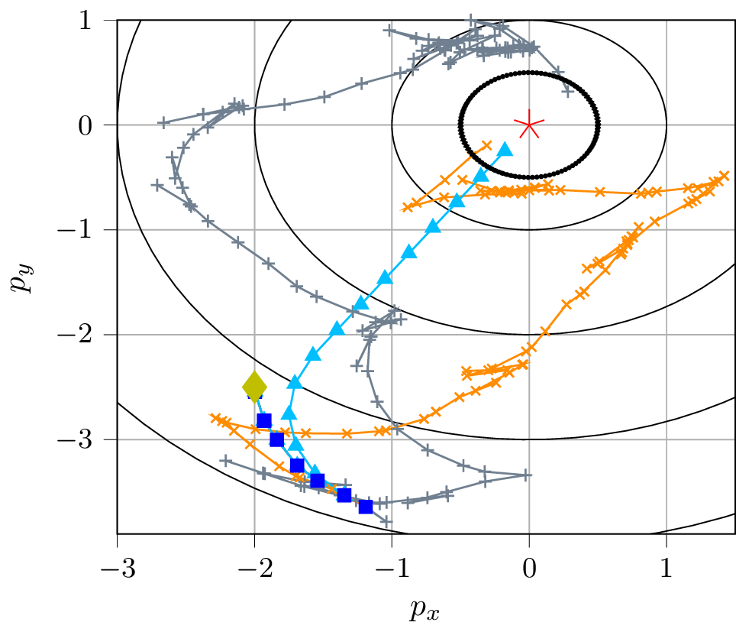
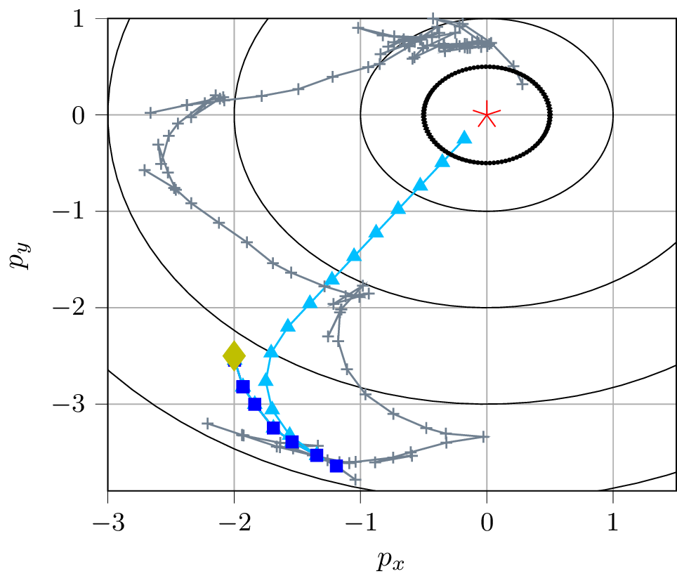
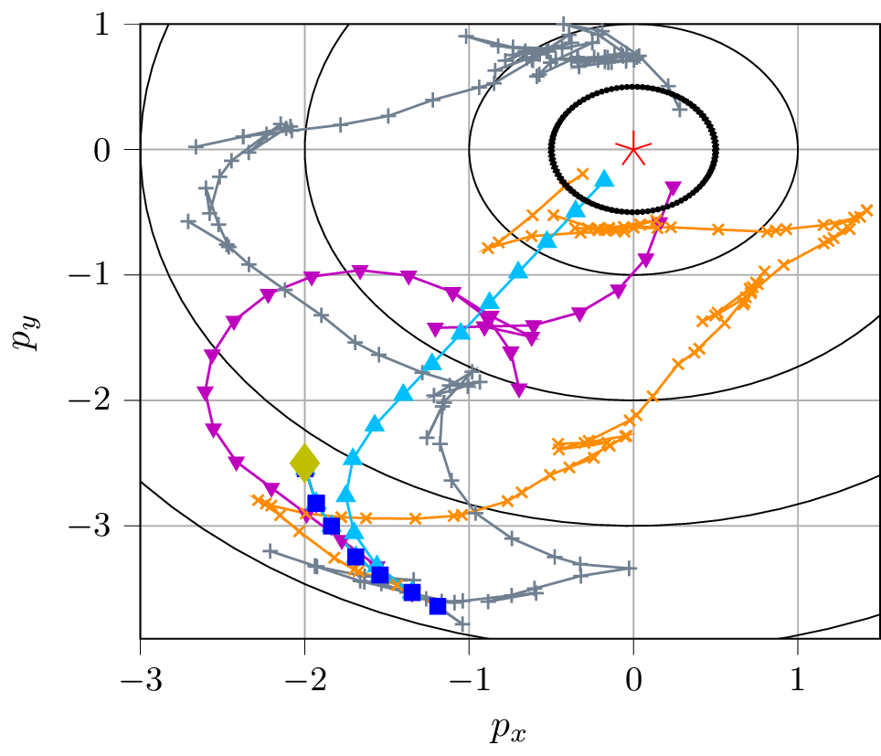
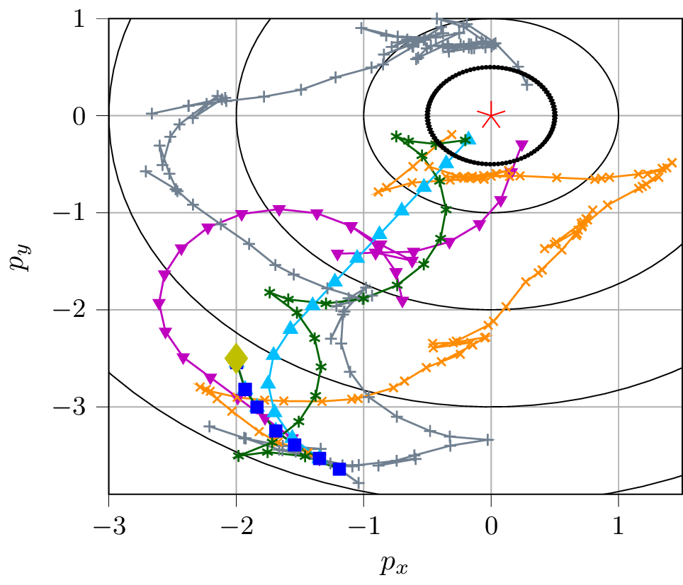
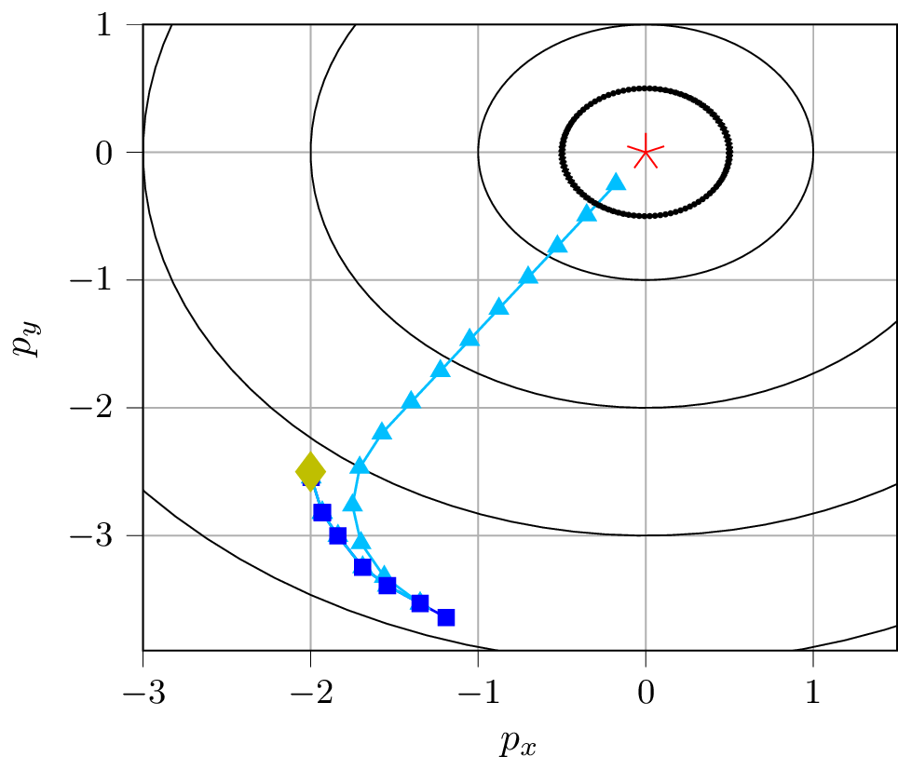
Data-Driven Control of a Unicycle System
Problem: Drive a unicycle to the origin solely based on data from ongoing trajectory and side information
CGP-LCB
Use Gaussian process to model the unknown cost function
Target state
Target set
Optimal trajectory
C2Opt
Approximate the unknown cost function via Lipschitz and gradient information
SINDYc
System identification via regression over a library of nonlinear functions
DaTaControl
The proposed approach
Initial state
Data points
DaTaControl successfully drives the unicycle to the target
Notes:
As for the numerical experiments, we first consider the problem of driving a unicyle system to the origin using only measurements from its ongoing trajectory and loose lipschitz bounds.
Furthermore we compare our approach with contextual optimization based approaches that seek to approximate the cost function and a system identification approach coupled with nonlinear model predictive control
We that our algorithm is able to successfully reach the target
Furthermore, the evolution of the cost function suggests that our algorithm is less suboptimal than the other approaches since it reaches the objective using fewer time steps
We also show that, in term of computation time, our algorithm is at least three orders of magnitude faster compared to the other approaches
We also investigate the problem of controlling the horizontal speed and altitude of a 6 state two control inputs quadrotor
Same story as for the unicyle, our algorithm uses data from ongoing trajectory, loose Lipschitz bounds, and elementary side information such as the knowledge that the speed is the derivative of the position
And as a results it is able to reach the setpoints while the other approaches failed.

Slide 13
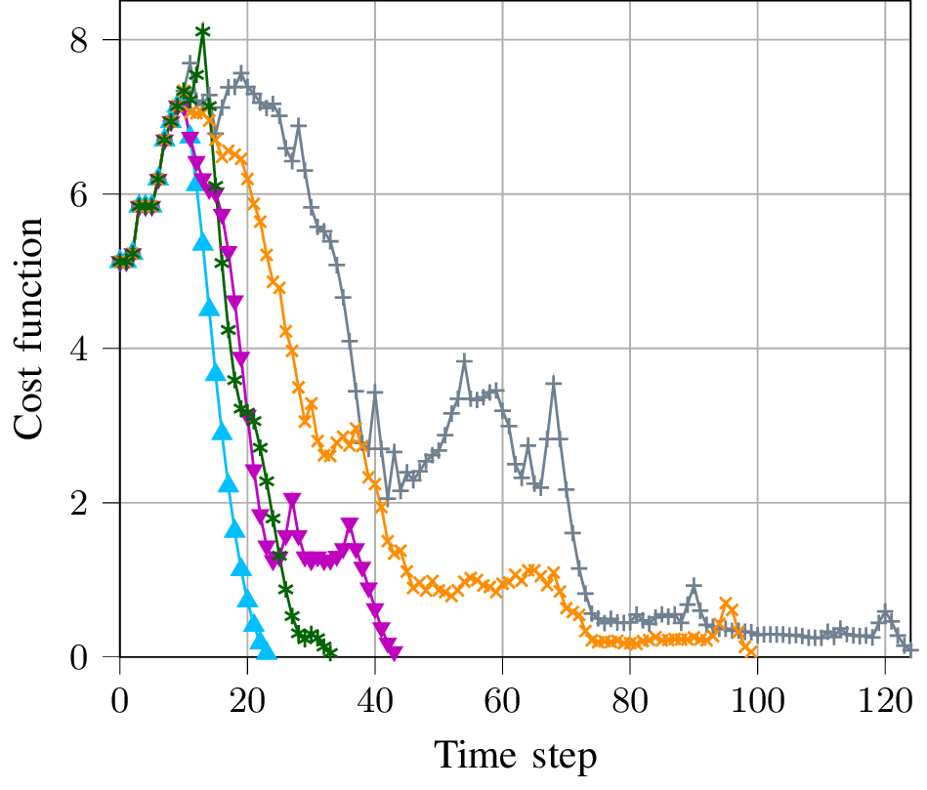
Data-Driven Control of a Unicycle System
Problem: Drive a unicycle to the origin solely based on data from ongoing trajectory and side information
CGP-LCB
C2Opt
Optimal trajectory
DaTaControl
SINDYc
DaTaControl performs significantly better than existing approaches

Slide 14
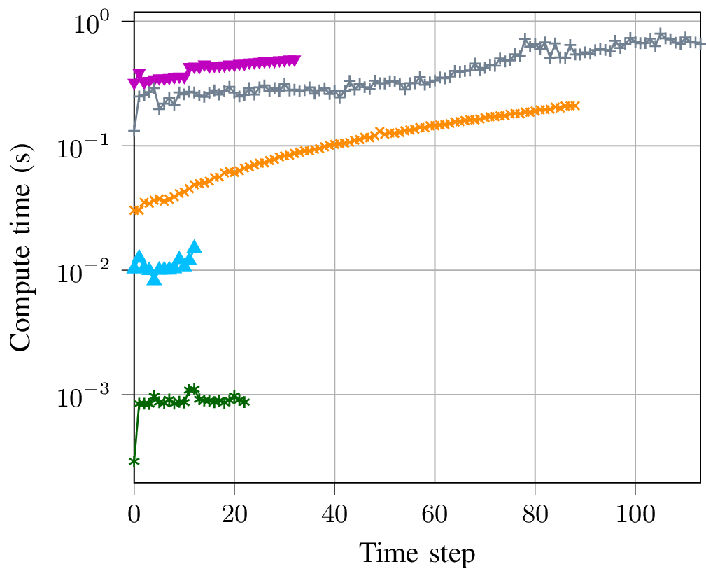
Data-Driven Control of a Unicycle System
Problem: Drive a unicycle to the origin solely based on data from ongoing trajectory and side information
CGP-LCB
SINDYc
C2Opt
Optimal trajectory
DaTaControl
DaTaControl is computationally faster than existing approaches

Slide 15
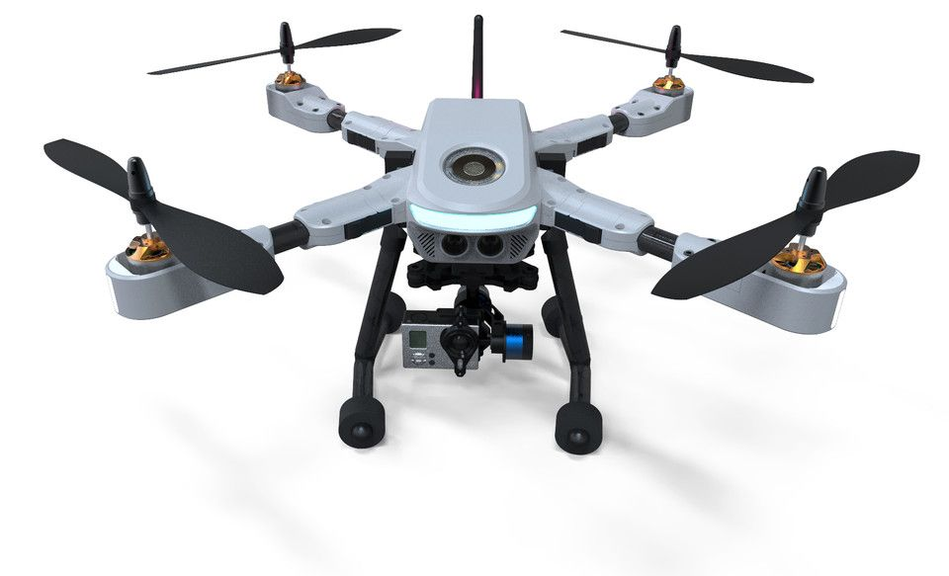
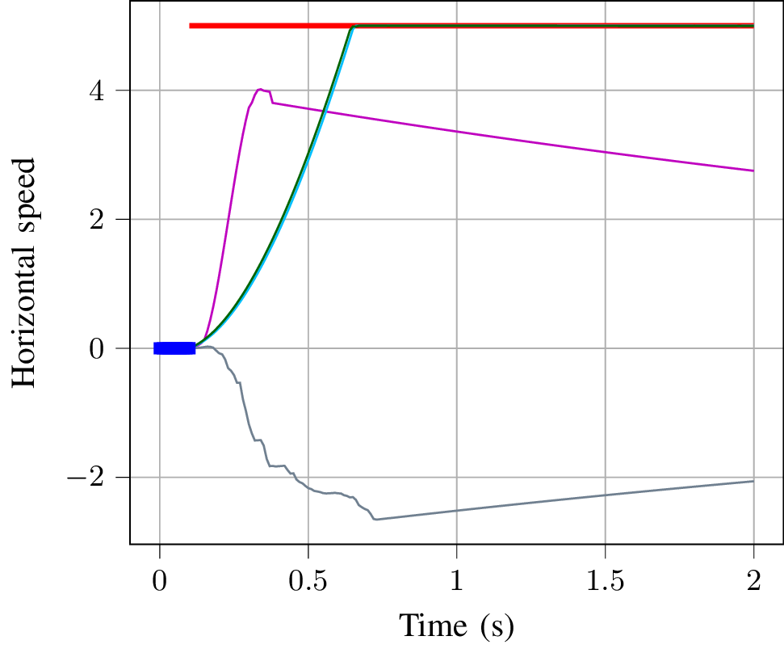
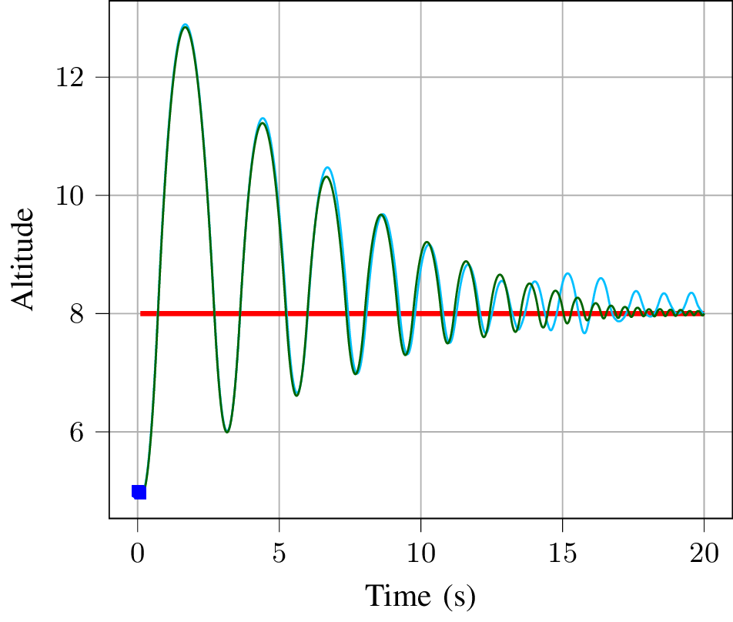
Data-Driven Control of a Quadrotor System
Problem: Control the altitude and horizontal speed of a quadrotor using data from ongoing trajectory
6-state control-affine nonlinear dynamics with two bounded control inputs
Side information
Knowledge of parts of the dynamics, i.e., speed is a time-derivative of position
Upper bound on the Lipschitz constants
Target state
SINDYc
DaTaControl
Optimal trajectory
Optimal trajectory
DaTaControl
CGP-LCB
Target state
SINDYc and CGP-LCB fail to reach the setpoints while DaTaControl succeeds in both cases

Slide 16
Conclusions
On-the-fly, near-optimal, data-driven control with side information via reachable sets
Over-approximations for various controls
Control with no side information
Control with side information
Goal
Optimal control
suboptimality error
Ongoing trajectory
Recent work: Data-driven control in a high-fidelity F-16 aircraft simulator
Notes:
To conclude this presentation, we develop in this work a data-driven, on-, near, control algoritm for unknown systems that can incorporate side information on the underlying dynamics through the computation of an over-approximation of the reachable sets
IN a recent submission to a conference, we went even one step ahead by applying this data-driven algorithm to control an F-16 aircraft ina high-fidelity simulator.

Slide 18
Thank you for listening
E-mail: fdjeumou@utexas.edu

